Slide 1

MICROSOFT WORD

Slide 2
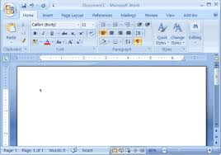
Word processors allow you to create, edit, and format text documents. Here’s how to use a basic word processing application:
HOW TO OPEN?
For Microsoft Word, click the Word icon on your desktop or Start menu (Windows) or Applications folder (Mac).

Slide 3

BASIC FUNCTIONS
Typing Text:
Click into the blank document and begin typing using the keyboard.
If typing is difficult, use speech-to-text tools:
Windows: Use Windows Speech Recognition to dictate text.
Mac: Use Voice Dictation by pressing the Function (fn) key twice to start dictation.

Slide 4
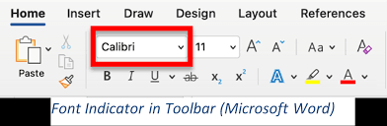
Formatting Text:
Highlight the text you want to format, and then:
Bold (Ctrl + B or Command + B)
Italic (Ctrl + I or Command + I)
Underline (Ctrl + U or Command + U)
Change Font Size and Style: Use the toolbar at the top to adjust the font style, size, and color.

Slide 5
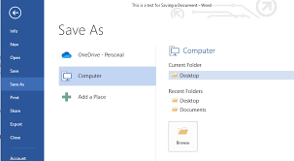
Saving Your Document:
Microsoft Word: Click File > Save As and choose a location on your computer.

Slide 6
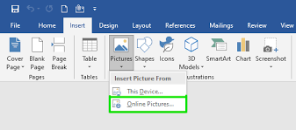
Inserting Images/Links:
Insert an Image: Click on the Insert tab, then Pictures (for Word) or Image (for Google Docs) to add images from your computer or the web.
Insert a Link: Highlight the text you want to link, click the Insert Link button (chain icon), and enter the URL.

Slide 7
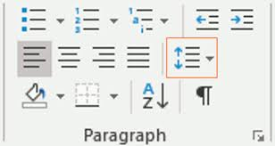
Paragraph Formatting
Text Alignment: You can align the text in different ways:
Left-aligned: Aligns text to the left margin.
Center-aligned: Centers text in the middle of the page.
Right-aligned: Aligns text to the right margin.
Justify: Aligns the text to both the left and right margins, creating a clean, uniform edge on both sides.

Slide 8
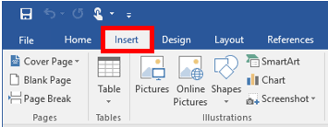
INSERT ELEMENTS
Tables: Word lets you add tables to organize information in rows and columns. You can insert a table of any size and format it to fit your needs.
Shapes and Icons: You can insert shapes (e.g., rectangles, circles, arrows) and icons to help illustrate points or make the document more interactive.
Links: You can insert hyperlinks that link to websites, other documents, or even specific places within the current document.
Text Boxes: Use text boxes to place text in a specific area of the page. This can be useful for adding side notes or drawing attention to certain parts of the page.

Slide 9
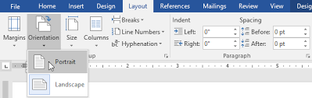
Page Layout and Design
Margins: Margins are the spaces around the edges of your document. You can adjust them to create a larger or smaller gap between your text and the edge of the page.
Orientation: You can choose between portrait orientation (vertical) and landscape orientation (horizontal) for the layout of your pages.
Page Size: Microsoft Word allows you to set the page size (A4, letter, etc.) to match the requirements of your document.

Slide 10
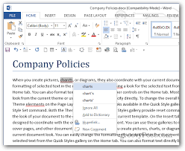
Spell Check and Grammar
Word automatically checks spelling and grammar as you type. Misspelled words are underlined in red, and grammar errors are underlined in blue. Right-clicking these words gives you suggestions for corrections.

Slide 11
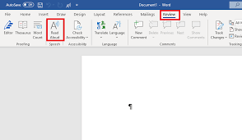
Word Count: You can easily check how many words, characters, and pages are in your document by using the Word Count feature.
Read Aloud: Read Aloud is a feature where Word reads your text out loud. This is helpful to catch mistakes you might not notice while reading silently.
Translation: If you need to translate your document into another language, Word has built-in translation tools to help you quickly convert text.

